Slide 1
CS5500 Final Project
⍍ Mock Stack Over Flow
Group Member: Cheng Shi, Kairuo Yan

Slide 2
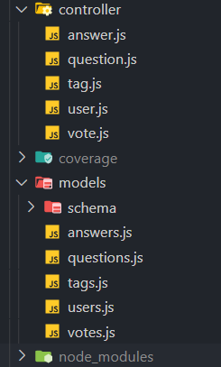
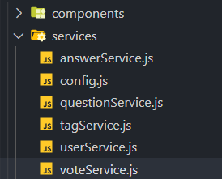
Software Architecture
In the high level , the whole web application is Client - Server artitecture with MVC. Utilizing RESTFul API for communications between them.
Server side is composite of Model and Controller which maintaining the data schema of the model entity representations. Server utilize express routing to divide each models’ related endpoints into their own controller. Different endpoint provide bunch of REST API which handles the requests and do the corresponding works and manipulates or retrieves the data stored in MongoDB and send back respondes.
Client side is the View utilizing React to divide rendering of user interfaces into components which can be reused and more modularized for scalability. Client encapsulates user actions into RESTful API requests and send request using axios to different endpoint of server by compose different request URL. Those API are also componentize into corresponding services each handle API calls for an specific models.

Slide 3
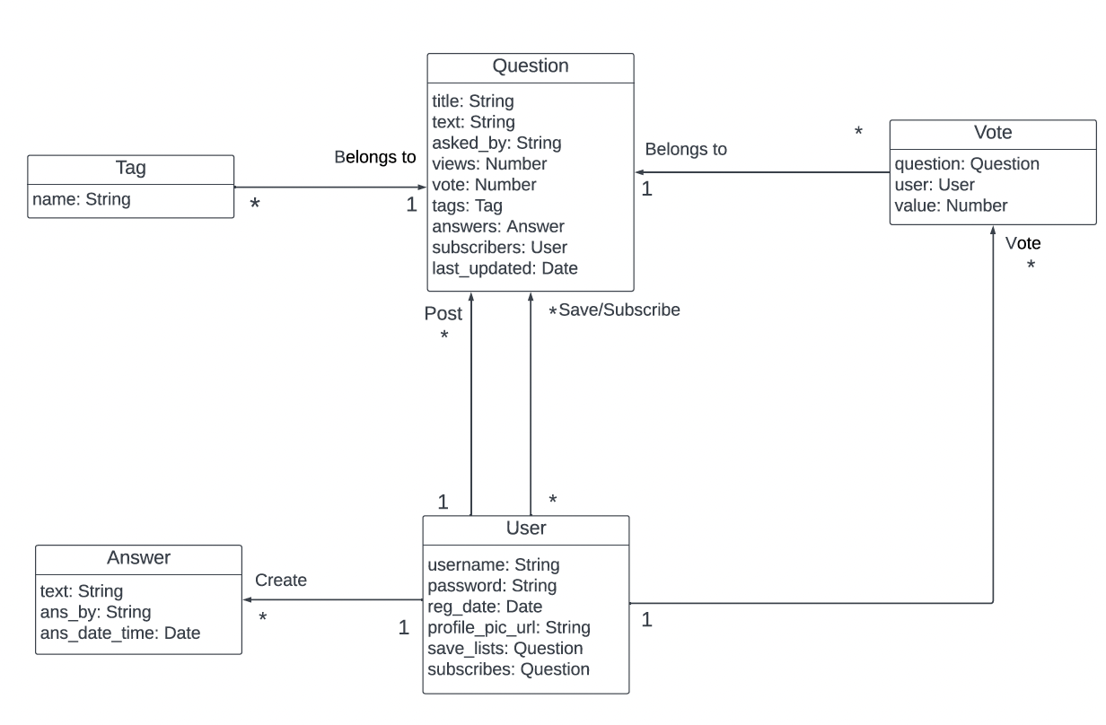
Schema

Slide 4
Security Mechanisms
✅DOS attack
Handled dos attack by always having a try catch block to handle request that have an situation we never thought of that might break the server from continues running.
✅Repudiation
We have a middlewares that log every request info mation into server.log which can be use to track down attacks.
✅Spoofing
We prevent spoofing by disable cookie for request beside HTTP and set cookies only expose to same site from CSRF. And variable secrets key entered as parameter everytime starts the server.
✅Privedge escalation
We have user register/login system which store userUniqueID into session.cookie when user is successfully logged in. So any privilege request will only be performed after authentication by checking the userid stored in sessions.
✅Tampering & Info Discolure
We define our own sanitizer for escaping HTML script from user input and SQL injections when processing user request from front end. Also we have a backup mechanism enabled in Mongo by set ‘sanitizedFilter’ to True and we always prevent direct useage of user inputs.

Slide 5
Development Process
Agile
test-driven development
refactoring code
frequent code review
Continuous Integration (CI): GitHub action
integrating code changes into a shared repository
use GitHub actions by defining a YAML file
Feature branches (Kairuo and Cheng) : Issue Tracking
test branch: testdev

Slide 6
Why?
Pro:
Flexibility
Streamlined Deployment
Collaboration and Visibility
Improved Code Quality
Reduced Debugging Time
Cons:
continuous involvement from stakeholders
writing tests out of the scratch needs training

Slide 7
Future Improvement
Spent more time prior to discuss and settle down the Interfaces and tests, other than define the interface and test case while devleoping
More commprehensive on testing for better coverages to make app more robust
Should follow loosely coupled schema design which might help maintenance easily.

